Slide 1
CHAP IX. An introduction to probability density function (PDF) method
Numerical Simulation
of
Turbulent Flows - LES

Slide 2
RANS
  Deterministic governing equations
  Mass:
  Momentum (i =1, 2, 3):
  Species (N species with k=1,..,N):
  Total enthalpy (ht = h + u_{i}u_{i}/2):
Reynolds stresses
XI. PDF method

Slide 3
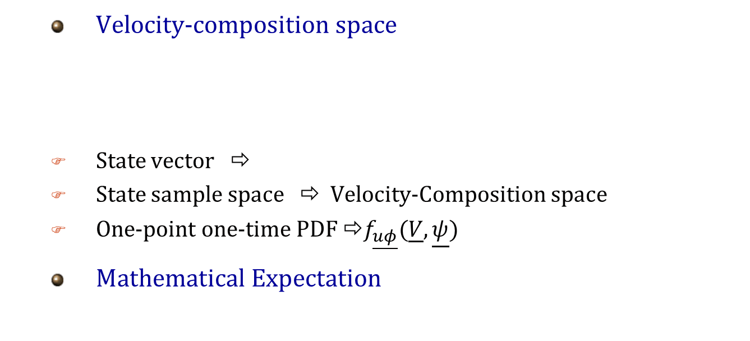
PDF
  Statistical point of view
  Any flow property is treated as a random variable.
  Velocity-composition space
  State vector ⇨
  State sample space ⇨ Velocity-Composition space
  One-point one-time PDF ⇨$f_{\underline{uφ}}(\underline{V},\underline{ψ})$
  Mathematical Expectation
XI. PDF method

Slide 4
Objective
  Knowing the joint PDF all average quantities can be calculated.
  Two Ways:
  Presumed Shape PDFs
    Via expeiments an assumed PDF as a function of mean and
    other Moments of flow quantities.
  PDF transport equation
XI. PDF method

Slide 5
PDF transport equation
Convection
Mean pressure gradient
and gravity
Reaction
Viscous stresses and fluctuating pressure gradient
Molecular diffusion
Mean pressure ⇨ Poisson equation
Closure problem is due to the effect of the unknown two-point information on one-point PDF transport equation.
XI. PDF method

Slide 6
Numerical Solution
  U and Φ transport eqs. are partial differential eqs. with 4 independent variables : x,t
  PDF transport eq. is a partial differential eq. with 8+N independent variables : x,t,V,ψ
  Finite difference, volume, and element ⇨ suitable for ⇨ small number of independent variables
  Monte Carlo particle methods ⇨ suitable for ⇨ large number of independent variables
XI. PDF method

Slide 7
Monte Carlo particle method
Eulerian
Simulation
Lagrangian
Simulation
Navier-Stokes equations
(PDEs)
Fluid particle transport
equation
(ODEs)
Modeled
PDF transport equation
(PDE)
Modeled
Parcel transport equation
(SDEs)
Monte Carlo
Simulation
XI. PDF method

Slide 8
Composition PDF
  Governing equations
  Scaler equations (State space)
  Navier-Stokes equations (Physical space)
  LES or RANS
  Closure
XI. PDF method

Slide 9
Composition PDF
Macro-mixing
Meso- mixing
Gradient diffusion
Micro-mixing
Reaction
Curl’s model
LIEM
, …
XI. PDF method

Slide 10
Semi-Eulerian Monte Carlo
Particles at time step n
  Fractional steps algorithm
  A grid of computational cells
  There are particles in each cell
  Each particle has a value
  Statistics in each cell at each time are calculated from the particles presented in that cell at the given time
Convection
And
Diffusion
Inter-cell processes
Micro-Mixing
Intra-cell
processes
Reaction
Particles at time step n+1
XI. PDF method

Slide 11
Flowchart of a sample code
RANS
(SIMPLE)
u_{i} Δp
ρ
FD
Solver
u_{i}
Fractional steps
Closure
k-ε model
k ε
Convection
And
Diffusion
Inter-cell processes
τ_{t}
u_{i}, p
Micro-Mixing
Composition
PDF
Y_{i} T
MC
Solver
Intra-cell
processes
Reaction
XI. PDF method

Slide 12
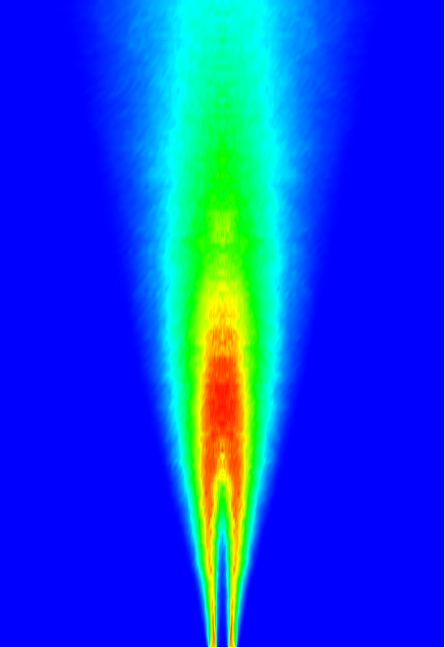
A sample PDF computation
  Turbulent piloted methane-air flame
  Sandia flame D (www.ca.sandia.gov/TNF)
Methane/Air jet
Hot pilot
Hot pilot
Air coflow
Air coflow
7.2 mm
18.856 mm
300 mm
XI. PDF method

Slide 13
Conclusion
RANS
LES | PDF
DNS
Increasing
Accuracy
Increasing
CPU time
RANS
LES
PDF
DES
DES-FDF
FDF
XI. PDF method

Slide 14
Numerical Simulation
of
Turbulent Flows - LES
Thank You
For
Your Attendance
Best Wishes

